Slide 1
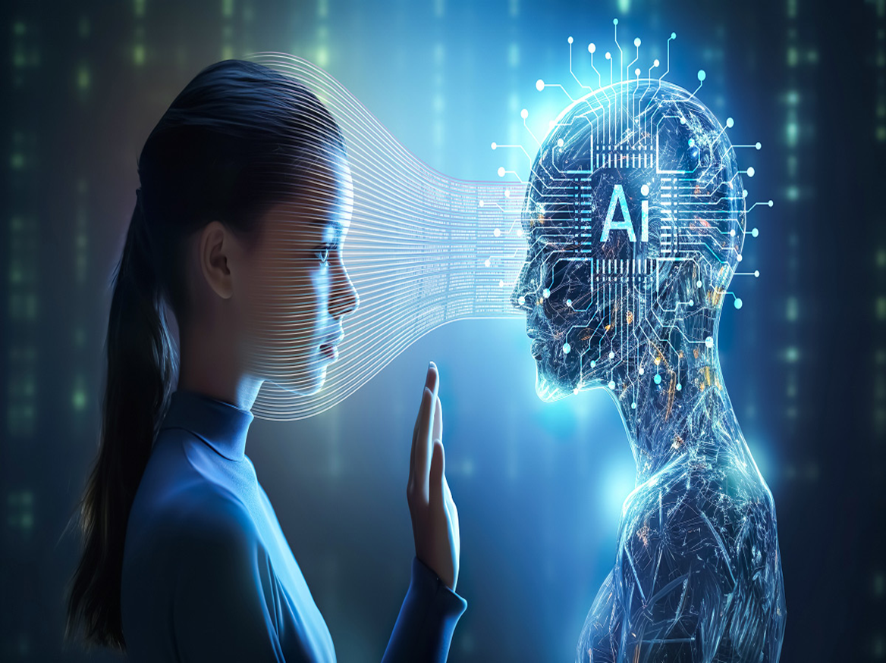
ARTIFICIAL INTELLIGENCE
Presented By:
smf5121472@gmail.com

Slide 2
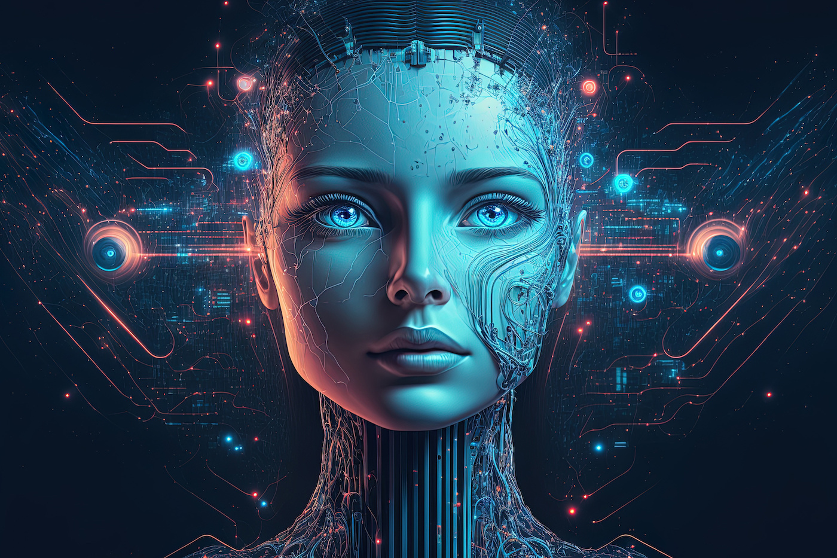
What is Artificial intelligence?
AI is the simulation of human intelligence by machines, including processes such as learning, reasoning, and self-correction.
Notes:
AI is the simulation of human intelligence by machines, including processes such as learning, reasoning, and self-correction.

Slide 3


Types of ai
Narrow ai
(weak ai)
General ai
(strong ai)
Super ai
Task-specific (e.g., Siri, Google Maps).
Can perform any intellectual task a human can do.
Exceeds human intelligence (future concept).

Slide 4
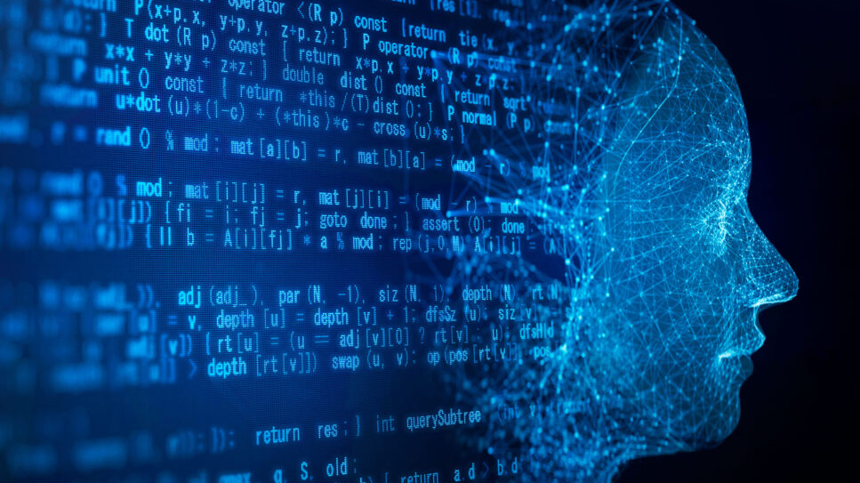
History
1940s-50s: Concept of intelligent machines emerges.
1956: Term "Artificial Intelligence" coined at Dartmouth Conference.
1960s-80s: Growth of AI algorithms and basic systems.
1990s-Present: Advances in machine learning, deep learning, and neural networks.

Slide 5

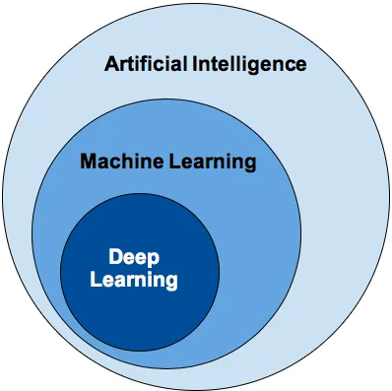
Core concepts in ai
ml
Machine Learning (ML): AI that learns from data. ​
dl
Deep Learning (DL): Subset of ML using neural networks.​
nlp
Natural Language Processing (NLP): Machines understanding human language.
​
Cv
Computer Vision: Image and video recognition.​

Slide 6

Advantages and Disadvantages of AI
ADVANTAGES
Speed and Accuracy
Error Reduction
Risk Management
Time Efficiency
DISADVANTAGES
High Cost
Job Displacement
Potential Misuse
Lack of Human Touch

Slide 7
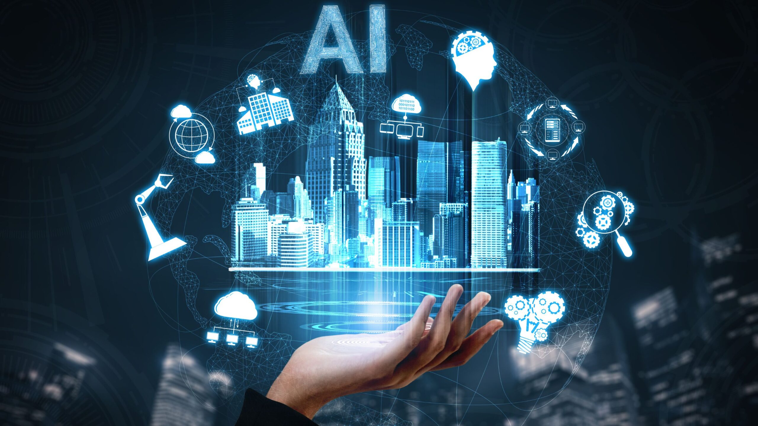
Applications of ai
Healthcare
Finance
Transportation
E-Commerce
Education

Slide 8
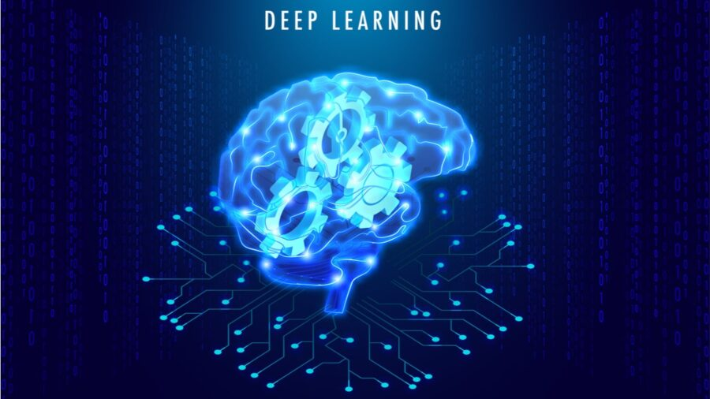
DEEP LEARNING
Deep Learning (DL) is a special type of Machine Learning that tries to mimic how the human brain works.
It uses artificial neural networks—layers of tiny “nodes” like brain cells—to solve very complex problems.

Slide 9

Key features
Representation Learning
Nonlinear Transformation
End-to-End Learning
Scalability

Slide 10
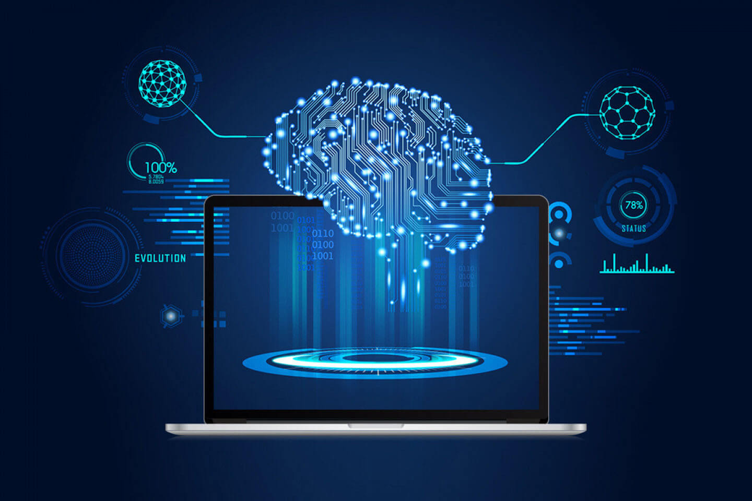
TYPES of dl
Feedforward Neural Network
Recurrent Neural Network
Convolutional Neural Network
Transformers

Slide 11
Advantages & disadvantages
Advantages
Disadvantages
Solves Complex Problems
Improved Accuracy with Large Data
Automation of Human Tasks
High Computational Requirements
Time-Consuming Training
Expensive to Develop and Run

Slide 12
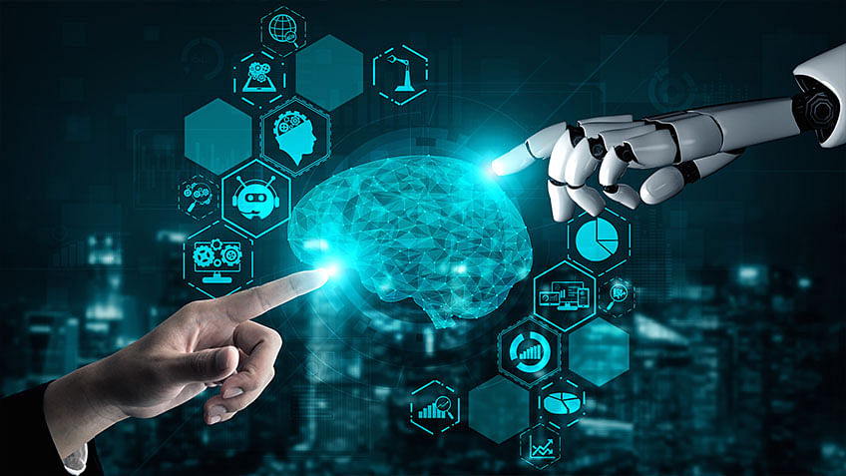
Applications
Image Processing
Speech Recognition
Healthcare
Finance
Gaming

Slide 13
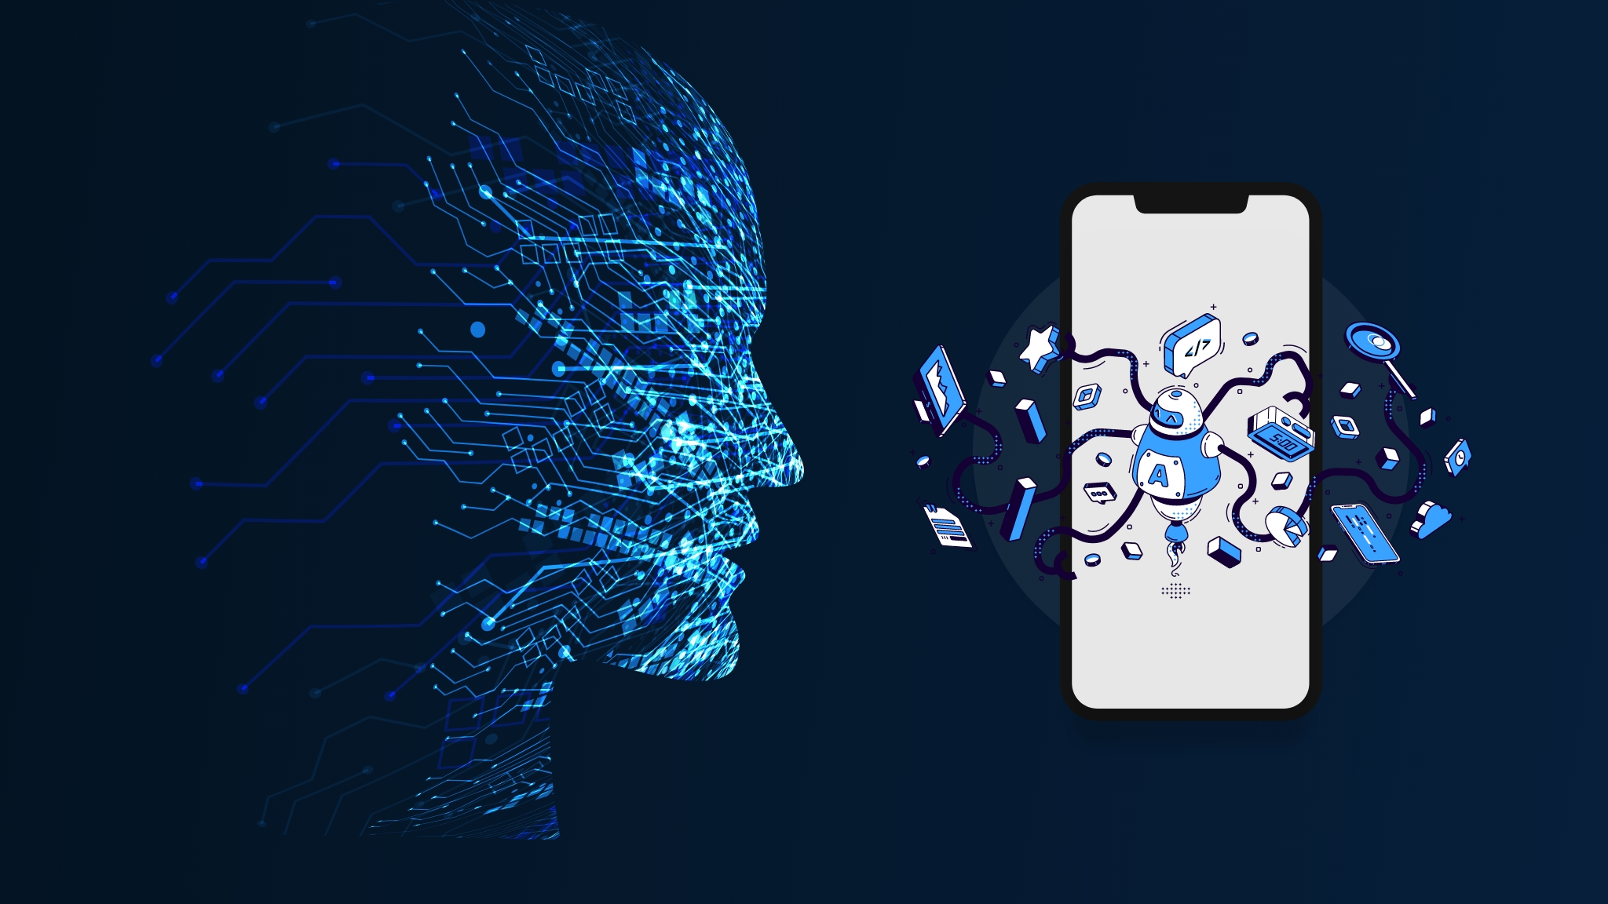
Apps commonly used in deep learning
Tensor flow
Keras
Google colab
Open cv

Slide 14

Future of AI, Machine Learning & Deep Learning
Artificial Intelligence
Smarter AI
Working with Humans
Understanding Emotions
Used Everywhere

Slide 15
Future of AI, Machine Learning & Deep Learning
Artificial Intelligence
Smarter AI
Working with Humans
Understanding Emotions
Used Everywhere
Machine Learning
Faster & Cheaper
Learning without Labels
Adapting in Real-Time
Custom Solutions

Slide 16
Future of AI, Machine Learning & Deep Learning
Artificial Intelligence
Smarter AI
Working with Humans
Understanding Emotions
Used Everywhere
Machine Learning
Faster & Cheaper
Learning without Labels
Adapting in Real-Time
Custom Solutions
Deep Learning
Better Algorithms
Combining Data Types
Quantum Computing

Slide 17
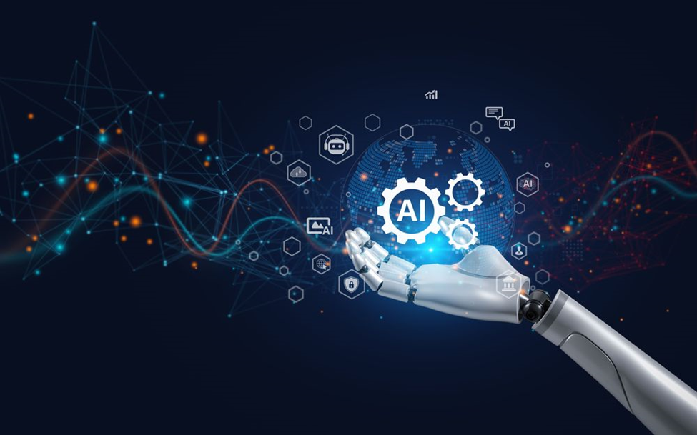
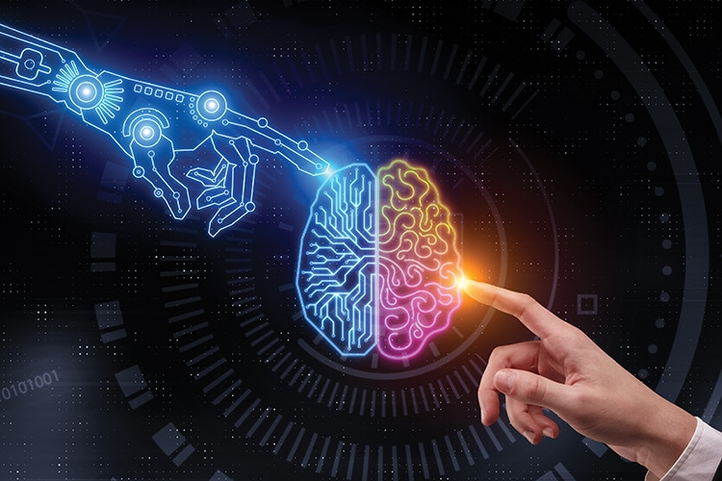

Technical Challenges
Need for Better Data
Difficult to Explain
High Costs
Poor Adaptability
Ethical Challenges
Fairness Problem
Privacy Issues
Job at Risk
Who is Responsible
CHALLENGES

Slide 18

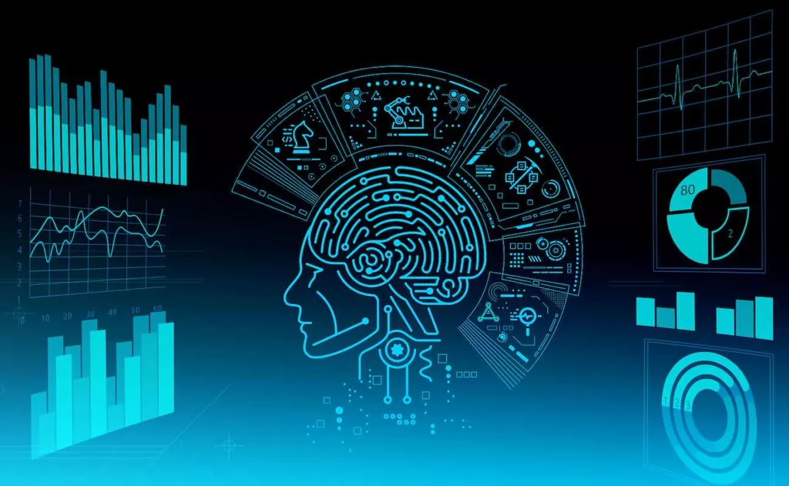
Security Challenges
Attacking AI Systems
Cyber Threats
Fake Content
Economic Challenges
Access for All
Big Companies' Control
CHALLENGES

Slide 19
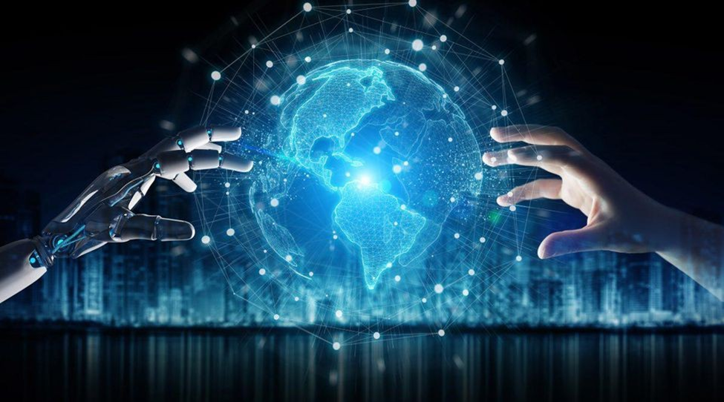
CONCLUSION
AI, ML, and DL are transforming industries and daily life.
Overcoming challenges is key to their safe, fair, and sustainable growth.
Key Takeaways:
Ethical Innovation
Collaboration
Sustainability

Slide 20
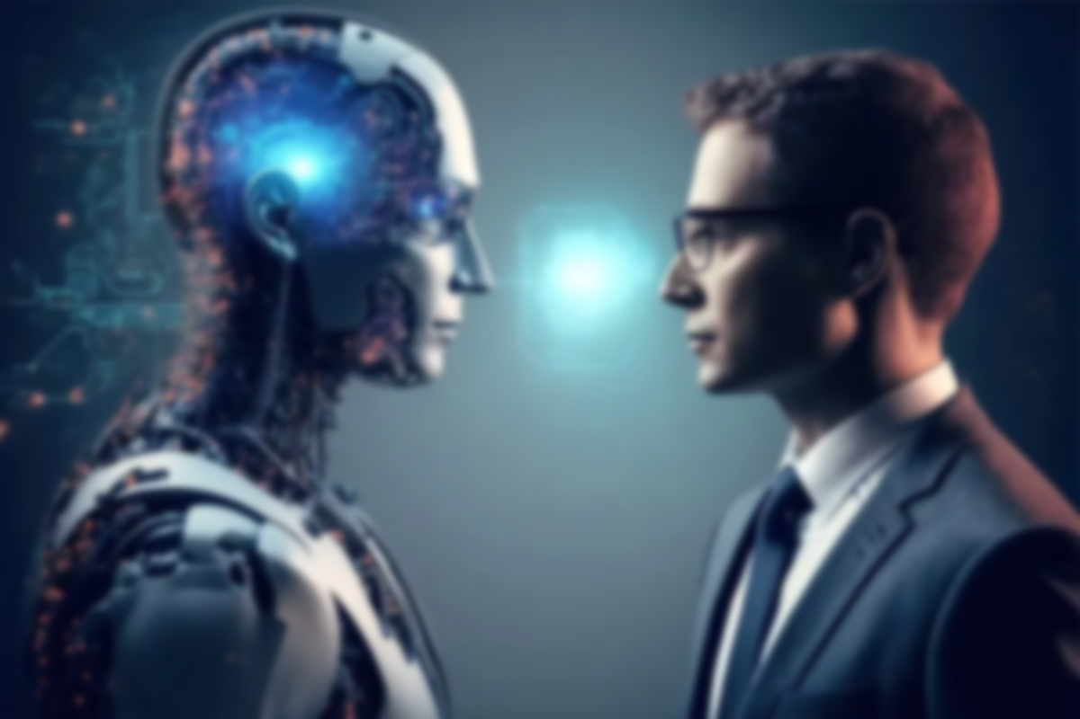
“Our INTELLIGENCE is what makes us human, and AI is an extension of that quality.”

Slide 21

Thank you

